Slide 1
2019 Vivli Datathon
Team: DATA HACK
Team Members: Vikas Gaikwad, Cynthia Frommit, Luther Evans, Annadoir Staveley, Het Patel & Vikraman Karunanidhi

Slide 2
Summary Description of Solution
Use of “machine learning” technology to create a data analytics tool whereby the researcher does not have to see the patient-level data.
Researchers are provided with a tool that masks the sensitive data with an image, but the analytical tool is able to read the data and conduct the analysis to provide the results for the researcher.
The tool will provide the necessary functionality to use the image for the data being used for analysis.
The key functionality of the solution is to provide a new method of data representation that protects data privacy and provides valuable metrics

Slide 3
Objective
Protect Patient Personal Information (PPI)
Provide a useful tool and service for researchers to conduct various real-word assessments on clinical data.

Slide 4

DATA REPRESENTATION
Sensitive Data will be masked with the image on the right
Variables are converted into matrix and save them into an image

Slide 5
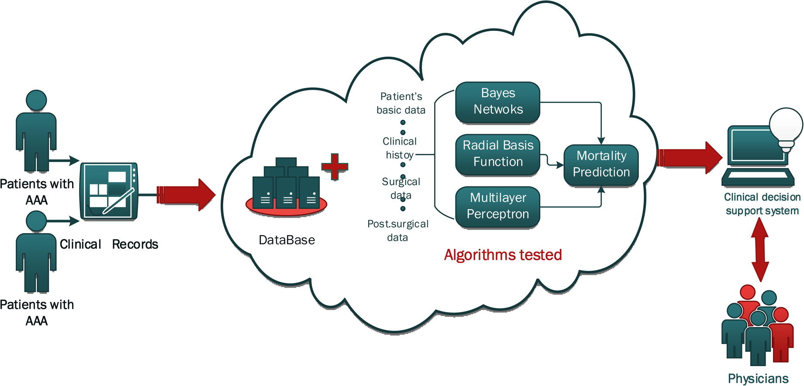
IMAGES

